Slide 1
ABCDDetailed Design
Huy Nguyen
October 10, 2019

Slide 2
Table of Contents
Layered Diagram
Avionics Functional Decomposition, as applicable (i.e. Algorithm Description Document exists)
Software functional overview
Cyclic Inputs
Event / Message Inputs
Cyclic Outputs
Visible Modifiable Outputs
Data Object Definition
Software Detailed Design
Class diagrams for new classes
Sequence diagrams for external event/message inputs
Requirements Trace
Software Usage Constraints

Slide 3
Layered Diagram Flight SW Architecture

Slide 4
Avionics Functional Decomposition

Slide 5
Control Moment Gyroscope Control Functional Overview
Hello hello hello
Possible control modes:
one
two
three
Also computes nothing
Does not perform anything

Slide 6
Control Moment Gyroscope Control Functional Overview (continued)
Supports the following uplink commands:
none
none
none
Generates the following parameters:
Param 1
Param 1
Param 1
Param 1
Param 1

Slide 7
Control Moment Gyroscope Control Detailed Design – Requirement Trace
SRS Requirement ID and Text | Software Function(s)
[VMC_SRS-2916] The thing does something in the something | Something::Function
[VMC_SRS-2917] The thing does something in the something | Something::Function
[VMC_SRS-2918] The thing does something in the something | Something::Function
[VMC_SRS-2919] The thing does something in the something | Something::Function

Slide 8
Control Moment Gyroscope Control Cyclic Inputs
Input Data Item | Destination Class | Data Source | Input Mechanism
Data Item | Class | AAAA | Input
Data Item | Class | AAAA | Input
Data Item | Class | AAAA | Input
Data Item | Class | AAAA | Input
Data Item | Class | AAAA | Input
Data Item | Class | AAAA | Input
Data Item | Class | AAAA | Input
Data Item | Class | AAAA | Input

Slide 9
Control Moment Gyroscope Control Event / Message Inputs
Input Message Data | Destination Class | Data Source
Input | Class | SOURCE
Input | Class | SOURCE
Input | Class | SOURCE
Input | Class | SOURCE

Slide 10
Control Moment Gyroscope Control Cyclic Outputs
Output Data Item | Generator Class
OUTPUT_ID | Class
OUTPUT_ID | Class
OUTPUT_ID | Class
OUTPUT_ID | Class
OUTPUT_ID | Class
OUTPUT_ID | Class
OUTPUT_ID | Class
OUTPUT_ID | Class

Slide 11
Control Moment Gyroscope Control Cyclic Outputs (Cont.)
Output Data Item | Generator Class
OUTPUT_DATA_ID | Class
OUTPUT_DATA_ID | Class
OUTPUT_DATA_ID | Class
OUTPUT_DATA_ID | Class
OUTPUT_DATA_ID | Class
OUTPUT_DATA_ID | Class
OUTPUT_DATA_ID | Class
OUTPUT_DATA_ID | Class
OUTPUT_DATA_ID | Class
OUTPUT_DATA_ID | Class

Slide 12
Control Moment Gyroscope Control Event / Message Outputs
Output Data Item | Destination Class | Data Source
OUTPUT_DATA_ID | CLASS | CMGC
OUTPUT_DATA_ID | CLASS | CMGC
OUTPUT_DATA_ID | CLASS | CMGC

Slide 13
Control Moment Gyroscope Control Visible / Modifiable Outputs
Output Data Item | Generator Class
OUTPUT_DATA_ID | Hello
OUTPUT_DATA_ID | Hello
OUTPUT_DATA_ID | Hello
OUTPUT_DATA_ID | Hello
OUTPUT_DATA_ID | Hello

Slide 14
Control Moment Gyroscope Control Data Object Definition
Output Data Item | Generator Class
Mounting Geometry
Vector | Hello_Gains
Vector | Hello_Gains
Control Gains | Hello_Gains
Scale Factor | Hello_Gains
Gain | Hello_Gains
Gain | Hello_Gains
Gain | Hello_Gains
Gain | Hello_Gains
Filter Gains | Hello_Gains
Gains 1 | Hello_Gains
Input Gains 2 | Hello_Gains
Gains 1 | Hello_Gains
Gains 2 | Hello_Gains

Slide 15
Control Moment Gyroscope Control Data Object Definition (Cont)
Output Data Item | Generator Class
CMG Control Limits and Thresholds
Rate Limit | Hello_Gains
Rate Limit | Hello_Gains
Acceleration Limit | Hello_Gains
Control Threshold | Hello_Gains
Threshold | Hello_Gains
Speed Threshold | Hello_Gains
Torque Control | Hello_Gains
Delay | Hello_Gains
Control | Hello_Gains
Singularity Avoidance Parameters | Hello_Gains
Gain | Hello_Gains
Amplitude | Hello_Gains
Frequency | Hello_Gains
Threshold | Hello_Gains

Slide 16
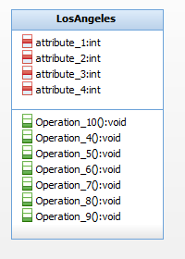
Control Moment Gyroscope Control Detailed Design –Class Diagram
Top level class for the periodic processing of the algorithm
Processes inputs and does stuff
Processes inputs and does stuff
Processes inputs and does stuff

Slide 17
CMGC Gains Detailed Design – Class Diagram
Manages various gains for ABCD

Slide 18
Control Gyroscope Control Command Handler Detailed Design – Class Diagram
The command handlers corresponding something
Validates nothing in some service
Queues the data

Slide 19
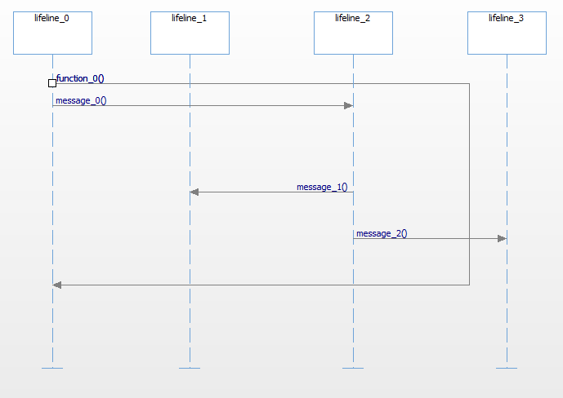
Control Moment Gyroscope Control – Elaborate Sequence Diagram

Slide 20
Control Moment Gyroscope Control – Initialize Sequence Diagram

Slide 21
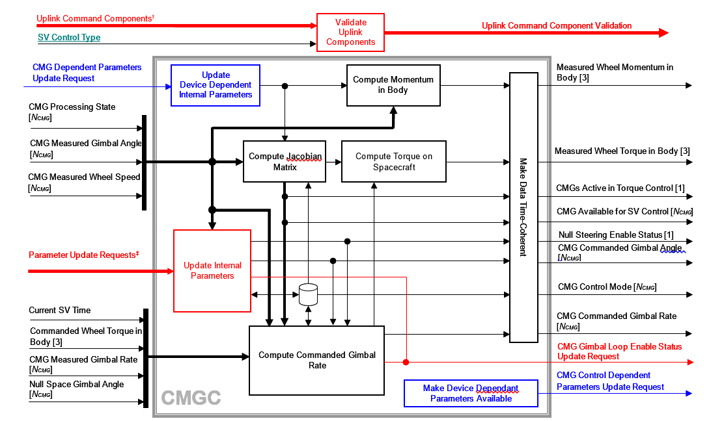
Control Moment Gyroscope Control Detailed Design –Class Diagram
Top level class for the periodic processing of the algorithm
Processes event input and update parameters
Computes total CMG momentum in body frame
Compute Jacobian matrix, torque on the spacecraft, and commanded gimbal rate
Make output time coherent

Slide 22
CMGC Gains Detailed Design – Class Diagram
Manages various gains for CMGC

Slide 23
Control Gyroscope Control Command Handler Detailed Design – Class Diagram
The command handlers corresponding to three CMGC uplink commands
Validates the uplink command data and returns the validation status to the Command Manager Service
Queues the data for the next cyclic processing cycle

Slide 24
Control Moment Gyroscope Control – Elaborate Sequence Diagram

Slide 25
Control Moment Gyroscope Control – Initialize Sequence Diagram

Slide 26
Control Moment Gyroscope Control – Periodic Cyclic Processing Sequence Diagram

Slide 27
Control Moment Gyroscope Control – Periodic Cyclic Processing Sequence Diagram

Slide 28
Control Moment Gyroscope Control Software Constraints
None

